Slide 1
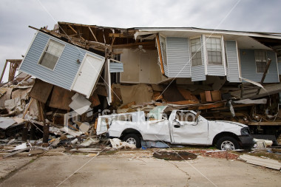
Preparing for Disasters
■Disasters in NC ■ Plan
■ Emergency Kit
Revised 10/2013

Slide 2
What are disasters?
Definition
Common NC disasters
Power Outages
Storms
Fire
Tornados
Earthquakes
Floods
Terror
Disease
Notes:
Floods
Hurricanes
Thunderstorms & Lightning
Tornadoes
Winter Storms & Extreme Cold
Fires
Extreme Heat
Earthquakes
Volcanoes
Landslides & Debris Flow
Tsunamis
Wildfires

Slide 3
Power Outage
Ice storm, wind, thunderstorm
No electricity for days or weeks
Be ready for 72 hours (3 days)
Notes:
Prepare for a Power Outage
To help preserve your food during a power outage, keep the following supplies in your home
One or more coolers—Inexpensive Styrofoam coolers work well.
Ice—Surrounding your food with ice in a cooler or in the refrigerator will keep food colder for a longer period of time during a prolonged blackout.
A digital quick-response thermometer— With these thermometers you can quickly check the internal temperatures of food to ensure they are cold enough to use safely.
Put together an emergency preparedness kit with these supplies in case of a prolonged or widespread power outage
Water—one gallon per person, per day (3-day supply for evacuation, 2-week supply for home)
Food—non-perishable, easy-to-prepare items (3-day supply for evacuation, 2-week supply for home)
Flashlight (Do not use candles during a power outage due to the extreme risk of fire.) [Available on the Red Cross Store]
Battery-powered or hand-crank radio (NOAA Weather Radio, if possible) [Available on the Red Cross Store]
Extra batteries
First aid kit [Available on the Red Cross Store]
Medications (7-day supply) and required medical items
Multi-purpose tool
Sanitation and personal hygiene items
Copies of personal documents (medication list and pertinent medical information, deed/lease to home, birth certificates, insurance policies)
Cell phone with chargers
Family and emergency contact information
Extra cash
If someone in your home is dependent on electric-powered, life-sustaining equipment, remember to include backup power in your evacuation plan
Keep a non-cordless telephone in your home. It is likely to work even when the power is out.
Keep your car’s gas tank full.

Slide 4
Power Outage in the Cold
Carbon Monoxide
NO grills
DO NOT heat with
a gas oven
Avoid generators inside
Staying warm
Notes:
Can lead to hypothermia, frostbite.
Caution: Carbon Monoxide Kills
Never use a generator, grill, camp stove or other gasoline, propane, natural gas or charcoal-burning devices inside a home, garage, basement, crawlspace or any partially enclosed area. Locate unit away from doors, windows and vents that could allow carbon monoxide to come indoors.
The primary hazards to avoid when using alternate sources for electricity, heating or cooking are carbon monoxide poisoning, electric shock and fire.
Install carbon monoxide alarms in central locations on every level of your home and outside sleeping areas to provide early warning of accumulating carbon monoxide.
If the carbon monoxide alarm sounds, move quickly to a fresh air location outdoors or by an open window or door.
Call for help from the fresh air location and remain there until emergency personnel arrive to assist you.
Winter Storm
Winter storms can range from a moderate snow over a few hours to a blizzard with blinding, wind-driven snow that lasts for several days. Some winter storms are large enough to affect several states, while others affect only a single community. Many winter storms are accompanied by dangerously low temperatures and sometimes by strong winds, icing, sleet and freezing rain.
Regardless of the severity of a winter storm, you should be prepared in order to remain safe during these events.
Know the Difference
Winter Storm Outlook - Winter storm conditions are possible in the next 2 to 5 days.
Winter Weather Advisory - Winter weather conditions are expected to cause significant inconveniences and may be hazardous. When caution is used, these situations should not be life threatening.
Winter Storm Watch - Winter storm conditions are possible within the next 36 to 48 hours. People in a watch area should review their winter storm plans and stay informed about weather conditions.
Winter Storm Warning - Life-threatening, severe winter conditions have begun or will begin within 24 hours. People in a warning area should take precautions immediately.
How to Prepare for a Winter Storm
Winterize your vehicle and keep the gas tank full. A full tank will keep the fuel line from freezing.
Insulate your home by installing storm windows or covering windows with plastic from the inside to keep cold air out.
Maintain heating equipment and chimneys by having them cleaned and inspected every year.
If you will be going away during cold weather, leave the heat on in your home, set to a temperature no lower than 55° F.
Put Together a Supply Kit
Sand, rock salt or non-clumping kitty litter to make walkways and steps less slippery
Warm coats, gloves or mittens, hats, boots and extra blankets and warm clothing for all household members
Ample alternate heating methods such as fireplaces or wood- or coal-burning stoves
Remaining Safe During a Winter Storm
Listen to a NOAA Weather Radio or other local news channels for critical information on snow storms and blizzards from the National Weather Service (NWS).
Bring pets/companion animals inside during winter weather. Move other animals or livestock to sheltered areas and make sure that their access to food and water is not blocked by snow drifts, ice or other obstacles.
Running water, even at a trickle, helps prevent pipes from freezing.
All fuel-burning equipment should be vented to the outside and kept clear.
Keep garage doors closed if there are water supply lines in the garage.
Open kitchen and bathroom cabinet doors to allow warmer air to circulate around the plumbing. Be sure to move any harmful cleaners and household chemicals up out of the reach of children.
Keep the thermostat set to the same temperature both during the day and at night. By temporarily suspending the use of lower nighttime temperatures, you may incur a higher heating bill, but you can prevent a much more costly repair job if pipes freeze and burst.
Go to a designated public shelter if your home loses power or heat during periods of extreme cold.
Avoid driving when conditions include sleet, freezing rain or drizzle, snow or dense fog. If travel is necessary, keep a disaster supplies kit in your vehicle.
Before tackling strenuous tasks in cold temperatures, consider your physical condition, the weather factors and the nature of the task.
Protect yourself from frostbite and hypothermia by wearing warm, loose-fitting, lightweight clothing in several layers. Stay indoors, if possible.
Help people who require special assistance such as elderly people living alone, people with disabilities and children.

Slide 5
Power Outage in the Heat
Staying cool
Drink water (no alcohol or sugary drinks)
Visit cool places
Notes:
Can lead to heat exhaustion or heat stroke.
Food Safety During a Power Outage
Keep refrigerator and freezer doors closed as much as possible. First use perishable food from the refrigerator. An unopened refrigerator will keep foods cold for about 4 hours.
Then use food from the freezer. A full freezer will keep the temperature for about 48 hours (24 hours if it is half full) if the door remains closed.
Use your non-perishable foods and staples after using food from the refrigerator and freezer.
If it looks like the power outage will continue beyond a day, prepare a cooler with ice for your freezer items.
Keep food in a dry, cool spot and keep it covered at all times.
Electrical Equipment During a Blackout
Turn off and unplug all unnecessary electrical equipment, including sensitive electronics.
Turn off or disconnect any appliances (like stoves), equipment or electronics you were using when the power went out. When power comes back on, surges or spikes can damage equipment.
Leave one light turned on so you’ll know when the power comes back on.
Eliminate unnecessary travel, especially by car. Traffic lights will be out and roads will be congested.
Read more about using generators safely.

Slide 6
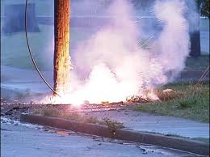
Storms Gas leaks
Types of Storms
Know local warning
Local shelters
Children – do not touch wires on the ground
Open Windows/Doors, shut off Gas
Notes:
All thunderstorms are dangerous. Every thunderstorm produces lightning. In the United States, an average of 300 people are injured and 80 people are killed each year by lightning.
Other associated dangers of thunderstorms include tornadoes, strong winds, hail, and flash flooding.
A thunderstorm is considered severe if it produces hail at least 1 inch in diameter or has wind gusts of at least 58 miles per hour. Every thunderstorm produces lightning, which kills more people each year than tornadoes or hurricanes. Heavy rain from thunderstorms can cause flash flooding, and high winds can damage homes and blow down trees and utility poles, causing widespread power outages.
Know the Difference
Severe Thunderstorm Watch - Severe thunderstorms are possible in and near the watch area. Stay informed and be ready to act if a severe thunderstorm warning is issued.
Severe Thunderstorm Warning - Severe weather has been reported by spotters or indicated by radar. Warnings indicate imminent danger to life and property.
Every year people are killed or seriously injured by severe thunderstorms despite advance warning. While some did not hear the warning, others heard the warning and did not pay attention to it. The information in this section, combined with timely watches and warnings about severe weather, may help save lives.
Hurricanes can produce widespread torrential rains. Floods are the deadly and destructive result.
Listen to a NOAA Weather Radio (Available on the Red Cross Store) for critical information from the National Weather Service (NWS).
Check your disaster supplies. Replace or restock as needed.
Bring in anything that can be picked up by the wind (bicycles, lawn furniture).
Close your windows, doors and hurricane shutters. If you do not have hurricane shutters, close and board up all windows and doors with plywood.
Turn your refrigerator and freezer to the coldest setting. Keep them closed as much as possible so that food will last longer if the power goes out.
Turn off propane tank.
Unplug small appliances.
Fill your car’s gas tank.
Create a hurricane evacuation plan with members of your household. Planning and practicing your evacuation plan minimizes confusion and fear during the event.
Find out about your community’s hurricane response plan. Plan routes to local shelters, register family members with special medical needs and make plans for your pets to be cared for.
Obey evacuation orders. Avoid flooded roads and washed out bridges.
Standard homeowners insurance doesn’t cover flooding. It’s important to have protection from the floods associated with hurricanes, tropical storms, heavy rains and other conditions that impact the U.S. For more information on flood insurance, please visit the National Flood Insurance Program Web site at www.FloodSmart.gov.
During a Winter Storm:
Listen to your radio, television, or NOAA Weather Radio for weather reports and emergency information.
Eat regularly and drink ample fluids, but avoid caffeine and alcohol.
Avoid overexertion when shoveling snow.
Watch for signs of frostbite.
Watch for signs of hypothermia.
Conserve fuel, if necessary, by keeping your residence cooler than normal.
Maintain ventilation when using kerosene heaters to avoid build-up of toxic fumes.
Everyone, especially children, should know not touch wires hanging from telephone polls or that are lying on the ground. This is true for any type of storm. Wires will still have electricity running to them, even if your lights don’t work, thus you can be electrocuted.

Slide 7
Fire Statistics
Notes:
U.S. fire departments responded to an estimated average of 358,300 home structure fires per year during 2010-2014, which represents three-quarters of all structure fires.
Home fires caused an annual average of:
2,520 civilian fire deaths, or 93% of all civilian structure fire deaths,
12,720 civilian fire injuries, or 87% of all civilian structure fire injuries, and
$6.7 billion in direct damage, or 69% of total direct damage in structure fires.
On average, seven people died in U.S. home fires per day.
Cooking equipment was the leading cause of home structure fires and home fire injuries and ties with heating as the second leading cause of home fire deaths.
Smoking was the leading cause of civilian home fire deaths. Heating equipment was the second most common cause of home fires, fire deaths, (tied with cooking), and fire injuries.

Slide 8
Fire – Be Ready
Check smoke detectors and extinguishers
Candle Caution
Know where to meet
Special needs?
Notes:
Each year, more than 4,000 Americans die and more than 25,000 are injured in fires, many of which could be prevented. Direct property loss due to fires is estimated at $8.6 billion annually.

Slide 9
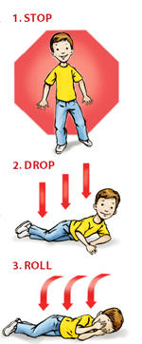
Fire
Remain Calm
Check door for heat
Crawl
Get out – or stay near window
STOP – DROP – ROLL
Follow signs in public buildings
Notes:
Install smoke alarms. Properly working smoke alarms decrease your chances of dying in a fire by half.
Place smoke alarms on every level of your residence. Place them outside bedrooms on the ceiling or high on the wall (4 to 12 inches from ceiling), at the top of open stairways, or at the bottom of enclosed stairs and near (but not in) the kitchen.
Test and clean smoke alarms once a month and replace batteries at least once a year. Replace smoke alarms once every 10 years.
Heating Sources
Check with your local fire department on the legality of using kerosene heaters in your community.
Place heaters at least three feet away from flammable materials.
Use only the type of fuel designated for your unit and follow manufacturer’s instructions.
Store ashes in a metal container outside and away from your residence.
Keep open flames away from walls, furniture, drapery, and flammable items.
Keep a screen in front of the fireplace.
Have heating units inspected and cleaned annually by a certified specialist.

Slide 10
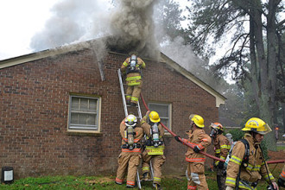
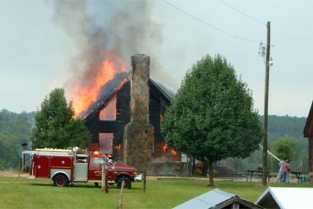
Fire
Apartment Fires
Lightning Strike Fires
Notes:
The first is an apartment fire in Wake County & the second is an apartment fire in Nash County.
The third is house fire caused by a lightning strike in August 2013 in Randolph County & the fourth is a house fire caused by a lightning strike in September 2013 in Warren County.
Did you know that if a fire starts in your home you may have as little as two minutes to escape? During a fire, early warning from a working smoke alarm plus a fire escape plan that has been practiced regularly can save lives. Learn what else to do to keep your loved ones safe!
Top Tips for Fire Safety
Install smoke alarms on every level of your home, inside bedrooms and outside sleeping areas.
Test smoke alarms every month. If they’re not working, change the batteries.
Talk with all family members about a fire escape plan and practice the plan twice a year.
If a fire occurs in your home, GET OUT, STAY OUT and CALL FOR HELP. Never go back inside for anything or anyone.

Slide 11
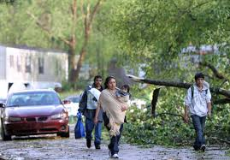
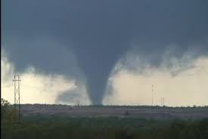
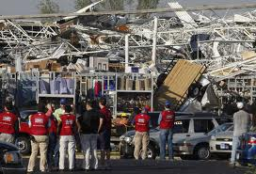
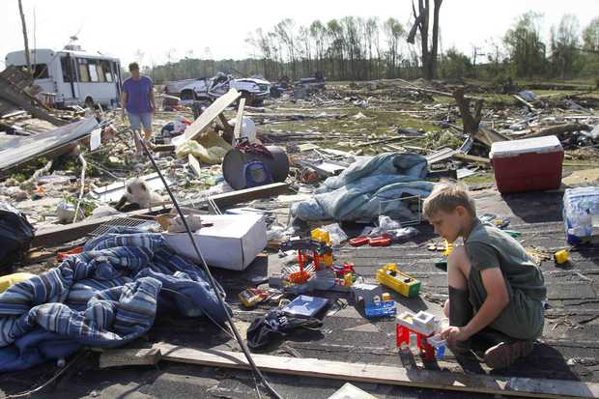
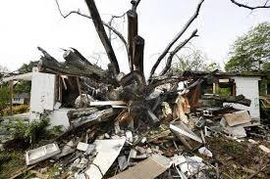
Tornado
Stay away from windows and items falling/flying – get into a basement, closet, or a bathroom (without windows)
Notes:
These are all images from the Raleigh 2011 tornado.
For Tornados
If you’re in a:
A structure (e.g. residence, small building, school, nursing home, hospital, factory, shopping center, high-rise building) - Go to a pre-designated shelter area such as a safe room, basement, storm cellar, or the lowest building level. Do not open windows.
A vehicle, trailer, or mobile home - Get out immediately and go to the lowest floor of a sturdy, nearby building or a storm shelter. Mobile homes, even if tied down, offer little protection from tornadoes.
The outside with no shelter - Lie flat in a nearby ditch or depression and cover your head with your hands; Watch out for flying debris.
Tornadoes are violent by nature. They are capable of completely destroying well-made structures, uprooting trees and hurling objects through the air like deadly missiles. A tornado is a violently rotating column of air extending from the base of a thunderstorm down to the ground. Tornado intensities are classified on the Fujita Scale with ratings between F0 (weakest) to F5 (strongest). Although severe tornadoes are more common in the Plains States, tornadoes have been reported in every state.
Know the Difference
Tornado Watch - Tornadoes are possible in and near the watch area. Review and discuss your emergency plans, and check supplies and your safe room. Be ready to act quickly if a warning is issued or you suspect a tornado is approaching. Acting early helps to save lives!
Tornado Warning - A tornado has been sighted or indicated by weather radar. Tornado warnings indicate imminent danger to life and property. Go immediately under ground to a basement, storm cellar or an interior room (closet, hallway or bathroom).
How to Prepare for a Tornado
During any storm, listen to local news or a NOAA Weather Radio to stay informed about tornado watches and warnings.
Know your community's warning system. Communities have different ways of warning residents about tornados, with many having sirens intended for outdoor warning purposes.
Pick a safe room in your home where household members and pets may gather during a tornado. This should be a basement, storm cellar or an interior room on the lowest floor with no windows.
Practice periodic tornado drills so that everyone knows what to do if a tornado is approaching.
Consider having your safe room reinforced. Plans for reinforcing an interior room to provide better protection can be found on the FEMA web site.
Prepare for high winds by removing diseased and damaged limbs from trees.
Move or secure lawn furniture, trash cans, hanging plants or anything else that can be picked up by the wind and become a projectile.
Watch for tornado danger signs:
Dark, often greenish clouds – a phenomenon caused by hail
Wall cloud – an isolated lowering of the base of a thunderstorm
Cloud of debris
Large hail
Funnel cloud – a visible rotating extension of the cloud base
Roaring noise
What to Do During a Tornado
The safest place to be is an underground shelter, basement or safe room.
If no underground shelter or safe room is available, a small, windowless interior room or hallway on the lowest level of a sturdy building is the safest alternative.
Mobile homes are not safe during tornadoes or other severe winds.
Do not seek shelter in a hallway or bathroom of a mobile home.
If you have access to a sturdy shelter or a vehicle, abandon your mobile home immediately.
Go to the nearest sturdy building or shelter immediately, using your seat belt if driving.
Do not wait until you see the tornado.
If you are caught outdoors, seek shelter in a basement, shelter or sturdy building. If you cannot quickly walk to a shelter:
Immediately get into a vehicle, buckle your seat belt and try to drive to the closest sturdy shelter.
If flying debris occurs while you are driving, pull over and park. Now you have the following options as a last resort:
Stay in the car with the seat belt on. Put your head down below the windows, covering with your hands and a blanket if possible. If you can safely get noticeably lower than the level of the roadway, exit your car and lie in that area, covering your head with your hands.
Your choice should be driven by your specific circumstances.

Slide 12
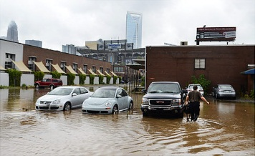
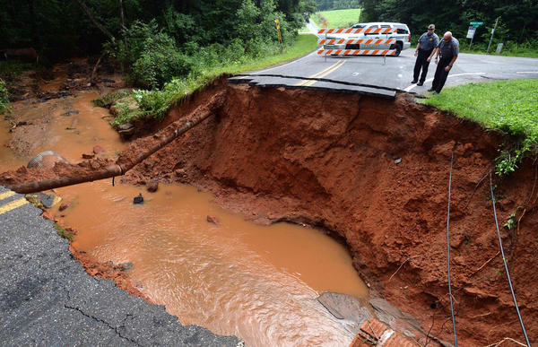
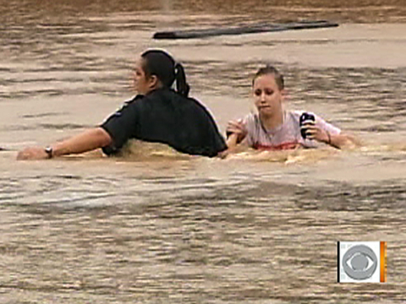
Flood
Leave your car if stuck
Get to higher ground
DO NOT drive through flood waters
Flash flood
Charlotte 2011
Notes:
If a flood is likely in your area, you should:
Listen to the radio or television for information.
Be aware that flash flooding can occur. If there is any possibility of a flash flood, move immediately to higher ground.
Be aware of streams, drainage channels, canyons, and other areas known to flood suddenly.
If you must prepare to evacuate, you should do the following: Secure your home. If you have time, bring in outdoor furniture. Move essential items to an upper floor.
Turn off utilities at the main switches or valves if instructed to do so. Disconnect electrical appliances. Do not touch electrical equipment if you are wet or standing in water.
After a Flood:
• Listen for news reports to learn whether the community’s water supply is safe to drink.
• Avoid floodwaters; water may be contaminated by oil, gasoline, or raw sewage.
• Avoid moving water.
• Be aware of areas where floodwaters have receded.
• Stay away from downed power lines, and report them to the power company.
• Return home only when authorities indicate it is safe.
• Stay out of any building if it is surrounded by floodwaters.
• Service damaged septic tanks, cesspools, pits, and leaching systems as soon as possible.
• Clean and disinfect everything that got wet.
Don't drive into a flooded area if you can avoid it
The first rule of driving in flooded waters is, DON'T. Find another route. That's the only sure way to avoid getting stranded.
When approaching a flooded area, you can't be sure of the depth of the water or the condition of the road beneath it, which may be broken up or washed away. Worst case, there may be no road left under the water.
Just 15 cm (6 inches) of standing water – sometimes less – can be enough to cause engine stalling. Your engine can suffer serious and expensive damage if it ingests water. And you'll be stranded.
In approximately 30 cm (1 foot) of water, a typical car can begin to float and, as traction is lost, so is steering control. If the water is moving, your vehicle could literally float away.
At 60 cm (two feet) of water, even larger vehicles such as pickup trucks and SUVs are in danger of floating away.
NEVER try driving through fast-moving water, such as an overflowing river, as your vehicle could be swept away.
As a rule of thumb, don't drive into water that's too deep to see the painted markings on the road.
If you can't avoid a flooded area and have to drive through it
Sometimes the flood water comes to you rather than the other way around or you have no alternative route available and you have to drive through it. When that happens, here are some precautions to take.
When approaching a depth of standing water on a road, always slow down before entering it. Even a very shallow depth of water can cause aquaplaning if entered at speed. The tires effectively lose contact with the road, resulting in a loss of steering control.
If there are other vehicles around, watch what happens to them as they drive through the water. Doing so will help you judge its depth and how it affects the vehicle as well as warn of any hidden hazards beneath the surface.
Proceed into the water very slowly and maintain a steady pace so as not to lose momentum. If you go too quickly you risk losing steering control. If you go too slowly, you run the risk of getting stuck.
Do not drive into water where downed power lines have fallen as electric current can be conducted by water.
Be particularly cautious entering a flooded area at night as it is much more difficult to identify potential hazards.
Be considerate of others. Driving through water at speeds above a slow crawl can create a splash that inhibits the visibility of other drivers and soaks pedestrians or people trying to direct traffic.
Be on the lookout for debris or other items that may float into your path.
Once you are through the flooded area, be aware that your brakes will be wet and will not function normally until they are dried out. Light brake applications will help them dry out and warm up more quickly.
If you should become stranded
In spite of your best efforts, conditions can change quickly and you may find yourself stranded. There is never one best course of action to cover every circumstance so analyze the situation and make the best choice you can. Here are some things to consider.
If your engine stalls and doesn't quickly restart, do not continue to try as doing so may cause further and more serious damage.
It's important to keep the situation from getting worse, so turn on your hazard warning lights to make sure other drivers can see you.
Use your cell phone to call for help.
If you can safely make it to higher ground on foot, leave the vehicle and do so. Be cautious of other traffic around you.
If it seems unsafe to leave the vehicle, stay with it. If the water level becomes too high inside, you may want to climb onto the roof to await assistance.
Whatever the circumstance, keep calm and think through the best course of action and its consequences.
The best advice of all, however, is simple. Do not to drive in flooded road conditions if at all possible.

Slide 13
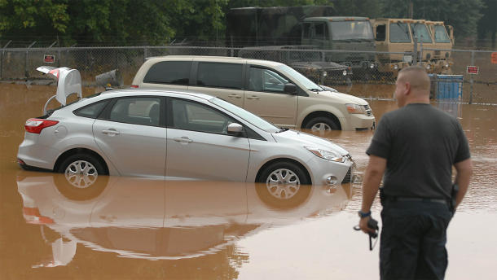
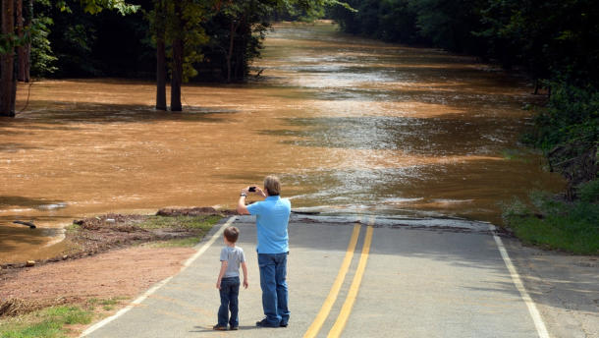
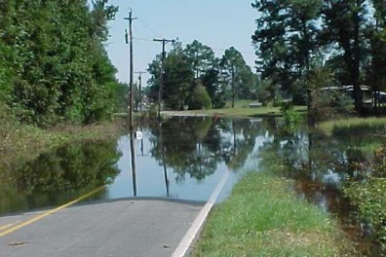
Flood
Lincolnton July 2013
Asheville May 2013
Lincolnton July 2013
Flooded street

Slide 14
Earthquake
Stay away from windows and falling items
Get in a door frame or under a desk
Notes:
Earthquakes are not very common in NC but they have been known to strike.
An earthquake is a sudden, rapid shaking of the earth caused by the breaking and shifting of rock beneath the earth’s surface. Earthquakes strike suddenly, without warning, and they can occur at any time of the year, day or night. Forty-five states and territories in the United States are at moderate to very high risk of earthquakes, and they are located in every region of the country. Learn how to prepare for an earthquake with the following safety tips provided by the American Red Cross.
Are You at Increased Risk from Earthquakes?
Contact your local emergency management office, local American Red Cross, state geological survey or department of natural resources for specific information about your community’s risk. However, bear in mind:
Mobile homes and homes not attached to their foundations are at particular risk during an earthquake.
Buildings with foundations resting on landfill and other unstable soils are at increased risk of damage.
Did You Know?
Doorways are no stronger than any other part of a structure so don’t rely on them for protection! During an earthquake, get under a sturdy piece of furniture and hold on. It will help shelter you from falling objects that could injure you during an earthquake.
If You Are Inside When the Shaking Starts...
Drop, cover and hold on. Move as little as possible.
If you are in bed, stay there, curl up and hold on. Protect your head with a pillow.
Stay away from windows to avoid being injured by shattered glass.
Stay indoors until the shaking stops and you are sure it is safe to exit. When it is, use stairs rather than the elevator in case there are aftershocks, power outages or other damage.
Be aware that fire alarms and sprinkler systems frequently go off in buildings during an earthquake, even if there is no fire.
If You Are Outside When the Shaking Starts...
Find a clear spot (away from buildings, power lines, trees, streetlights) and drop to the ground. Stay there until the shaking stops.
If you are in a vehicle, pull over to a clear location and stop. Avoid bridges, overpasses and power lines if possible. Stay inside with your seatbelt fastened until the shaking stops. Then, drive carefully, avoiding bridges and ramps that may have been damaged.
If a power line falls on your vehicle, do not get out. Wait for assistance.
If you are in a mountainous area or near unstable slopes or cliffs, be alert for falling rocks and other debris. Landslides are often triggered by earthquakes.

Slide 15
Other Emergencies
Terror
Chemical
Stay calm
Follow instructions
For Bomb Threats – don’t use a cell phone
Spills
Chemical Plant Fires
Leave your home if ordered to
If no evacuation, stay indoors until after officials say spill is contained
Notes:
Technological Hazards: Technological hazards include hazardous materials incidents and nuclear power plant failures. Occur with little or no warning.
Include: Hazardous Materials Incidents and Nuclear Power Plants
1. Explosions
2. Biological Threats
3. Chemical Threats
4. Nuclear Blasts
5. Radiological Dispersion Device (RDD)
What to Do If a Terrorism Event Occurs
Remain calm and be patient.
Follow the advice of local emergency officials.
Listen to your radio or television for news and instructions.
If the event occurs near you, check for injuries. Give first aid and get help for seriously injured people.
If the event occurs near your home while you are there, check for damage using a flashlight. Do not light matches or candles or turn on electrical switches. Check for fires, fire hazards and other household hazards. Sniff for gas leaks, starting at the water heater. If you smell gas or suspect a leak, turn off the main gas valve, open windows, and get everyone outside quickly.
Shut off any other damaged utilities.
Confine or secure your pets.
Call your family contact—do not use the telephone again unless it is a life-threatening emergency.
Check on your neighbors, especially those who are elderly or disabled.
A Word on What Could Happen
As we’ve learned from previous events, the following things can happen after a terrorist attack:
There can be significant numbers of casualties and/or damage to buildings and the infrastructure. So employers need up-to-date information about any medical needs you may have and on how to contact your designated beneficiaries.
Heavy law enforcement involvement at local, state and federal levels follows a terrorist attack due to the event's criminal nature.
Health and mental health resources in the affected communities can be strained to their limits, maybe even overwhelmed.
Extensive media coverage, strong public fear and international implications and consequences can continue for a prolonged period.
Workplaces and schools may be closed, and there may be restrictions on domestic and international travel.
You and your family or household may have to evacuate an area, avoiding roads blocked for your safety.
Clean-up may take many months.
About Chemical Emergencies
Chemicals are a natural and important part of our environment. Even though we often don't think about it, we use chemicals every day. Chemicals help keep our food fresh and our bodies clean. They help our plants grow and fuel our cars. And chemicals make it possible for us to live longer, healthier lives.
Under certain conditions, chemicals can also be poisonous or have a harmful effect on your health. Some chemicals that are safe, and even helpful in small amounts, can be harmful in larger quantities or under certain conditions.
Chemical accidents do happen, at home and in the community. The American Red Cross wants you to be prepared by following our chemical emergency preparedness recommendations.
How You May Be Exposed to a Chemical
You may be exposed to a chemical in three ways:
Breathing the chemical
Swallowing contaminated food, water, or medication
Touching the chemical, or coming into contact with clothing or things that have touched the chemical
Remember, you may be exposed to chemicals even though you may not be able to see or smell anything unusual. Chemical Accidents Can Be Prevented. Chemicals are found everywhere – in our kitchens, medicine cabinets, basements, and garages. In fact, most chemical accidents occur in our own homes. And they can be prevented.

Slide 16
Disease
Find Facts
Avian influenza “bird flu” does NOT spread easily to humans
Call Centers for Disease Control and Prevention 1-800-232-4636
www.cdc.gov/
Notes:
Know the Difference: Types of Flu Outbreaks
Seasonal Flu—A contagious respiratory illness caused by influenza (flu) viruses occurring every year. It affects an average of 5 percent to 20 percent of the U.S. population by causing mild to severe illness, and in some instances can lead to death.
Epidemic—The rapid spread of a disease that affects some or many people in a community or region at the same time.
Pandemic—An outbreak of a disease that affects large numbers of people throughout the world and spreads rapidly.
H1N1 Influenza (swine flu)—H1N1 influenza is a respiratory disease of pigs caused by type A influenza viruses that cause regular outbreaks in pigs. People do not normally get H1N1 influenza, but human infections can and do happen. H1N1 influenza viruses have been reported to spread from person-to-person.
Avian Influenza—Commonly known as bird flu, this strain of influenza virus is naturally occurring in birds. Wild birds can carry the virus and may not get sick from it; however, domestic birds may become infected by the virus and often die from it.
Are you considered high risk for flu-related complications?
You are at an increased risk if you are:
Age 50 or older
Pregnant
Living with a chronic medical condition
A child, age 6 months and older
Living with or caring for anyone at high risk
If you are at high risk, have your vaccinations updated every year, as directed by your physician.

Slide 17
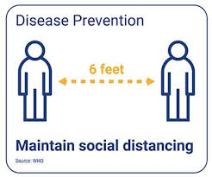
Pandemic
COVID-19
Wear a mask! Social Distancing
www.cdc.gov/
Notes:
Know the Difference: Types of Flu Outbreaks
Seasonal Flu—A contagious respiratory illness caused by influenza (flu) viruses occurring every year. It affects an average of 5 percent to 20 percent of the U.S. population by causing mild to severe illness, and in some instances can lead to death.
Epidemic—The rapid spread of a disease that affects some or many people in a community or region at the same time.
Pandemic—An outbreak of a disease that affects large numbers of people throughout the world and spreads rapidly.
H1N1 Influenza (swine flu)—H1N1 influenza is a respiratory disease of pigs caused by type A influenza viruses that cause regular outbreaks in pigs. People do not normally get H1N1 influenza, but human infections can and do happen. H1N1 influenza viruses have been reported to spread from person-to-person.
Avian Influenza—Commonly known as bird flu, this strain of influenza virus is naturally occurring in birds. Wild birds can carry the virus and may not get sick from it; however, domestic birds may become infected by the virus and often die from it.
Are you considered high risk for flu-related complications?
You are at an increased risk if you are:
Age 50 or older
Pregnant
Living with a chronic medical condition
A child, age 6 months and older
Living with or caring for anyone at high risk
If you are at high risk, have your vaccinations updated every year, as directed by your physician.

Slide 18
Plan
Be Ready for 72 hours (3 days)
Who will you call? Person out-of-town, long distance phone lines
Where will you be? Meeting places: one near home and one outside neighborhood
Elderly, disabled, no English, pets, kids?
Notes:
Long distance phone lines often work before local phone lines, so identify an out-of-state contact and provide this person with the contact information of people you want to keep informed of your situation

Slide 19
Evacuate If local officials issue evacuation orders – follow them!
Bring $, credit cards, cell phone, charger, important #s, medications
Pet needs collar, food, & crate
Lock your home, turn off water and electricity, but leave gas on unless instructed otherwise
Call your contact once you are safe
Notes:
Always:
Keep a full tank of gas
Make transportation arrangements
Listen to a battery-powered radio and follow local evacuation instructions.
Evacuate immediately.
Leave early.
Follow recommended evacuation routes.
Be alert for washed-out roads and bridges. Do not drive into flooded areas.
Stay away from downed power lines.
If time permits:
Gather your disaster supplies kit.
Wear sturdy shoes and clothing that provides some protection, such as long pants, long-sleeved shirts, and a cap.
Secure your home:
Close and lock doors and windows.
Unplug electrical equipment, such as radios and televisions, and small appliances, such as toasters and microwaves.
Leave freezers and refrigerators plugged in unless there is a risk of flooding.
Let others know where you are going.
Other Plans:
Community
School and/or Daycare
Workplace
Other Considerations:
Emergency Planning Checklist
Escape Routes
Family Communication
Utility Shut Off & Safety
Natural Gas – only if instructed
Water
Electricity

Slide 20
Kit & Go-Bag
Water
Food

Slide 21
Disaster Kit
First Aid Kit
Medications
Copy of documents and numbers
Warm clothes
Gloves
Personal Hygiene – toilet paper, soap
Tools
Special needs
Notes:
You may need to survive on your own after a disaster. This means having your own food, water, and other supplies in sufficient quantity to last for at least 3 days.
Kit Locations
Home
Work
Car
Be Prepared for an Emergency. Be Red Cross Ready! Being prepared means being equipped with the proper supplies you may need in the event of an emergency or disaster. Keep your supplies in an easy-to-carry emergency preparedness kit that you can use at home or take with you in case you must evacuate.
At a minimum, you should have the basic supplies listed below:
Water: one gallon per person, per day (3-day supply for evacuation, 2-week supply for home)
Food: non-perishable, easy-to-prepare items (3-day supply for evacuation, 2-week supply for home).
Flashlight [Available on the Red Cross Store]
Battery-powered or hand-crank radio (NOAA Weather Radio, if possible) [Available on the Red Cross Store]
Extra batteries
First aid kit [Available on the Red Cross Store]
Medications (7-day supply) and medical items
Multi-purpose tool
Sanitation and personal hygiene items
Copies of personal documents (medication list and pertinent medical information, proof of address, deed/lease to home, passports, birth certificates, insurance policies)
Cell phone with chargers
Family and emergency contact information
Extra cash
Emergency blanket [Available on the Red Cross Store]
Map(s) of the area
Consider the needs of all family members and add supplies to your kit. Suggested items to help meet additional needs are:
Medical supplies (hearing aids with extra batteries, glasses, contact lenses, syringes, etc)
Baby supplies (bottles, formula, baby food, diapers)
Games and activities for children
Pet supplies (collar, leash, ID, food, carrier, bowl)
Two-way radios
Extra set of car keys and house keys
Manual can opener
Additional supplies to keep at home or in your survival kit based on the types of disasters common to your area:
Whistle
N95 or surgical masks
Matches
Rain gear
Towels
Work gloves
Tools/supplies for securing your home
Extra clothing, hat and sturdy shoes
Plastic sheeting
Duct tape
Scissors
Household liquid bleach
Entertainment items
Blankets or sleeping bags

Slide 22
Go-Bag: One per person with ID tag
Flashlight
Radio – battery operated
Whistle
Pocket knife
Cash and change
Clothes and shoes
Map
Medications
Toys
Copy of documents
Pictures of kids
and pets
Notes:
Insurance & Vital Records
Inventory Home Possessions
Important Documents
Money
Special Needs
Pets

Slide 23
Water
1 Gallon per person per day
Store in 2L Soda bottles
Change tap water every 6 months
Change store bought water 1x a year
Extra water for cooking and hygiene

Slide 24
Food
3 days
Canned, no cooking, no refrigeration
Rotate
Fridge – 4 hours
Freezer – 2 days
Manual can opener
Notes:
Leave door closed on fridge and freezer. If unopened:
Food in the fridge will keep for 4 hours
Food in the freezer will keep for 2 days

Slide 25
NC Resources
www.readync.org
www.listonc.org – Spanish
www.redcross.org

